Slide 1
Lecture: 10 Broadcast receiver android

Slide 2



What is broadcast receiver:
A broadcast receiver in Android development is a component that allows you to listen for and handle broadcast messages from other applications or from the system itself. Broadcast messages are intents that are broadcasted system-wide by the system or applications. They can be sent to communicate between different parts of the same app, or between different apps altogether. These messages can inform all interested applications about certain events, such as when the screen turns off, the battery is low, airplane mode in ON or when a photograph is taken.

Slide 3

Continue:
Broadcast receivers respond to explicit or implicit intents:
Implicit Broadcasts: These are broadcasts that aren't targeted at a specific app. For example, ACTION_BATTERY_LOW is an implicit intent indicating that the battery level has reached a low level. Any app that has a broadcast receiver for this intent can respond accordingly, such as by saving data or restricting intensive operations.
Explicit Broadcasts: These are sent directly to a specific component within an application, typically used for internal communication within the app.
In summary:
Implicit broadcasts are like the public billboard: general announcements meant for anyone who is interested and is listening.
Explicit broadcasts are like personal mail: targeted messages meant only for a specific recipient who is directly addressed.

Slide 4


Real world analogy: implicit broadcast receiver
when the device is connected to Wi-Fi, the operating system sends out a broadcast that Wi-Fi is available. This is akin to the restaurant's public address system where announcements like "Wi-Fi is now available!" are made. In this mobile context, the news app (and any other app that is interested) might use this information to start downloading high-quality content only available when Wi-Fi is connected. The app is set to listen for this kind of system-wide broadcast, but so are many other apps.

Slide 5

Real world analogy: explicit broadcast receiver
When WhatsApp receives a new message from the server, it might use an explicit broadcast within its app to notify the chat interface to update with the new message. This broadcast is only relevant to WhatsApp itself, directing the message notification to the specific part of the app that handles the display of new messages.

Slide 6

Types of broadcast receiver:
Static Broadcast Receivers: These types of Receivers are declared in the Manifest file and works even if the app is closed.
Dynamic Broadcast Receivers: These types of receivers work only if the app is active or minimized.

Slide 7

Static broadcast example:
Example Scenario: Headphone Connection/Disconnection
When a user plugs in or unplugs headphones, Google Play Music or Spotify can automatically pause or resume playback to prevent music from playing out loud unexpectedly. This is managed by a static broadcast receiver that listens for system broadcasts about headphone status changes. This receiver is declared in the app’s manifest file, allowing it to respond to these events even if the app is not currently running.

Slide 8

dynamic broadcast example:
Example Scenario: Music Control Notifications
While using Spotify or Google Play Music, if the user interacts with music control notifications (like play, pause, or skip), the app uses dynamic broadcast receivers to handle these actions. These receivers are only active while the app is running, ensuring efficient resource use and that the app only responds to these controls when it can immediately affect playback.

Slide 9
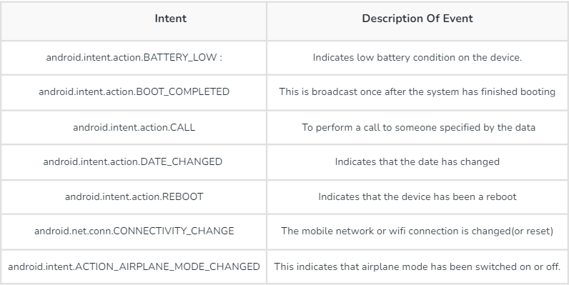
Intents for broadcast receiver

Slide 10
Lifecycle/steps for broadcast receiver
Instantiation: A Broadcast Receiver is typically declared in the AndroidManifest.xml file, or it can be registered dynamically in code using the registerReceiver() method. If declared in the manifest, it is instantiated when the app's package is first installed.
onReceive(): This method is the core of a Broadcast Receiver. When a broadcast that the receiver is registered to listen for is sent, the system invokes the onReceive() method of the receiver. This is where you put the code to handle the broadcast.
Lifetime: Once the onReceive() method execution is completed, the Broadcast Receiver is considered inactive until another broadcast is received. Unlike activities or services, Broadcast Receivers do not have a specific lifecycle beyond this. They are activated when a matching broadcast is sent, and they go out of scope once their onReceive() method completes.

Slide 11


Steps involved in broadcast receiver

Slide 12
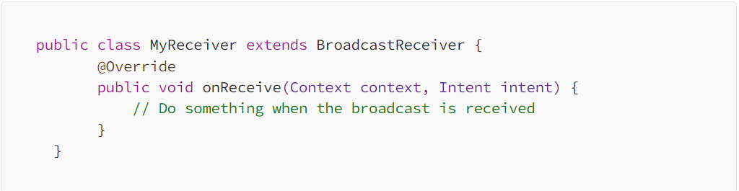
creating the broadcast receiver
Step 1 : create a new Java class that extends the BroadcastReceiver class

Slide 13
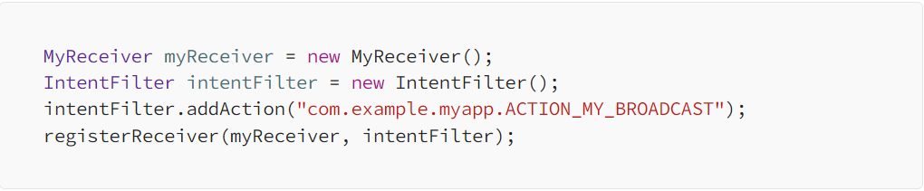
Registerng the broadcast receiver
Step 2 : in your activity or service, create an instance of your receiver class and register it with the system using an IntentFilter

Slide 14
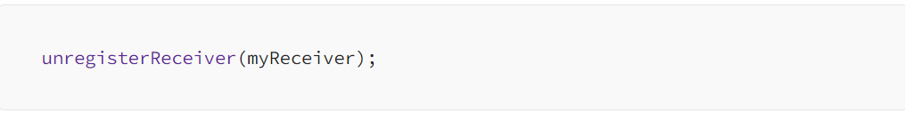
Unregistering the broadcast receiver
Don’t forget to unregister the receiver when you’re done using it to avoid memory

Slide 15
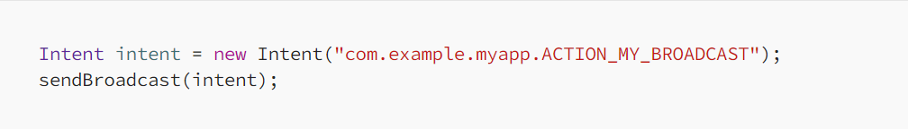
Sending the broadcast
Step 3 : you can send the broadcast from anywhere in your app using an Intent object with the specified action
When the broadcast is sent, the onReceive() method in your MyReceiver class will be called, allowing you to perform any necessary actions in response to the broadcast.

Slide 16
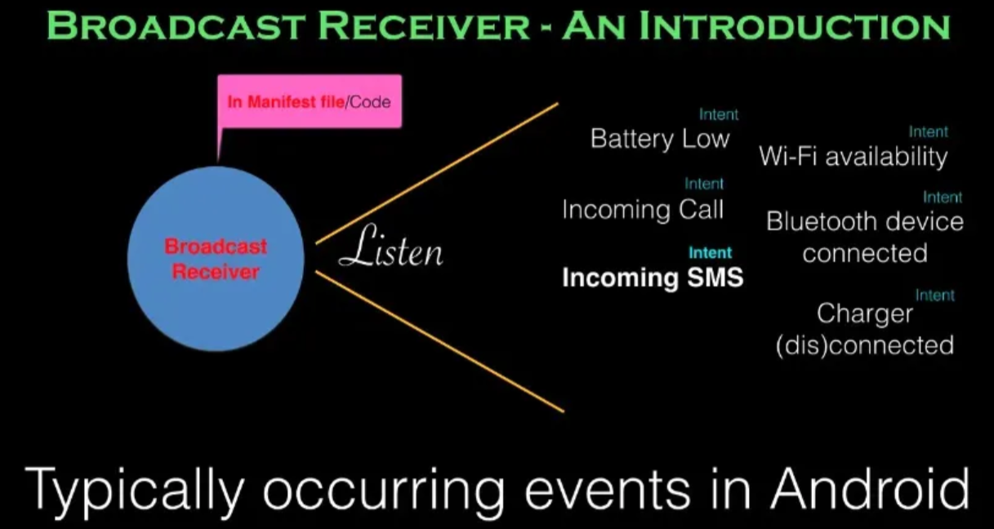

Slide 17
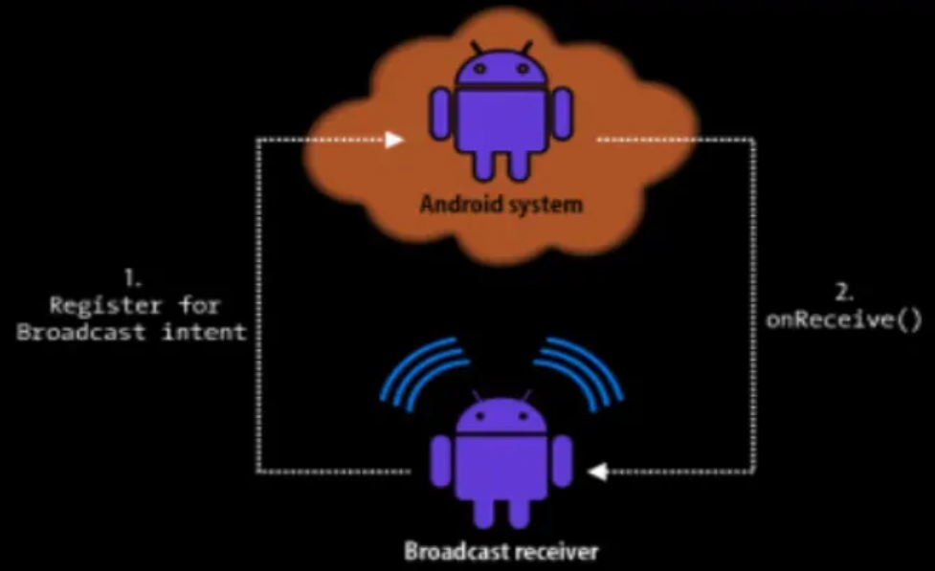

Slide 18

Code example:

Slide 19
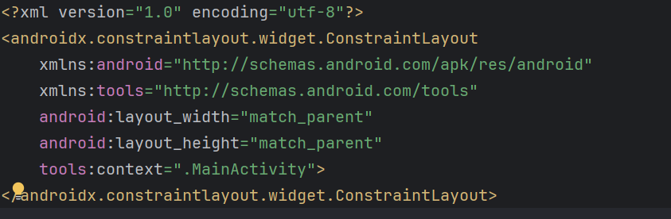
Activity.xml

Slide 20
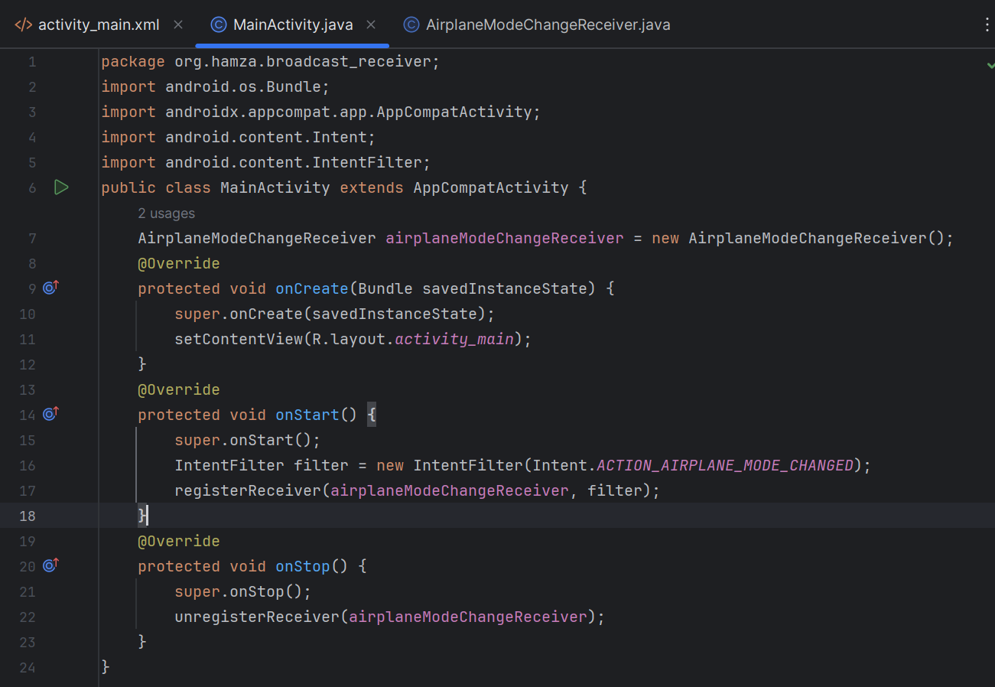
Main_activity.java

Slide 21

Super.onstart ()
Super.onstart() in the code:
It's like saying, "First, do all the usual things that every activity should do when it starts, according to the Android system."
After that, you can do extra things specific to your activity.

Slide 22

General rules when starting application
Boot Application: An activity “starts" when you open the app. This is like the activity turning on its brain to get ready for the day.
Setting up the Layout: This includes things like setting up the layout of the screen – where buttons, images, and text will go.
Load Data: An activity might also need to load up some data it will use, like pictures or information, so it's ready to show them to you when you need them.
Setup Connections: An activity might set up any tools or connections it needs, like connecting to the internet to get the latest news or updates.

Slide 23
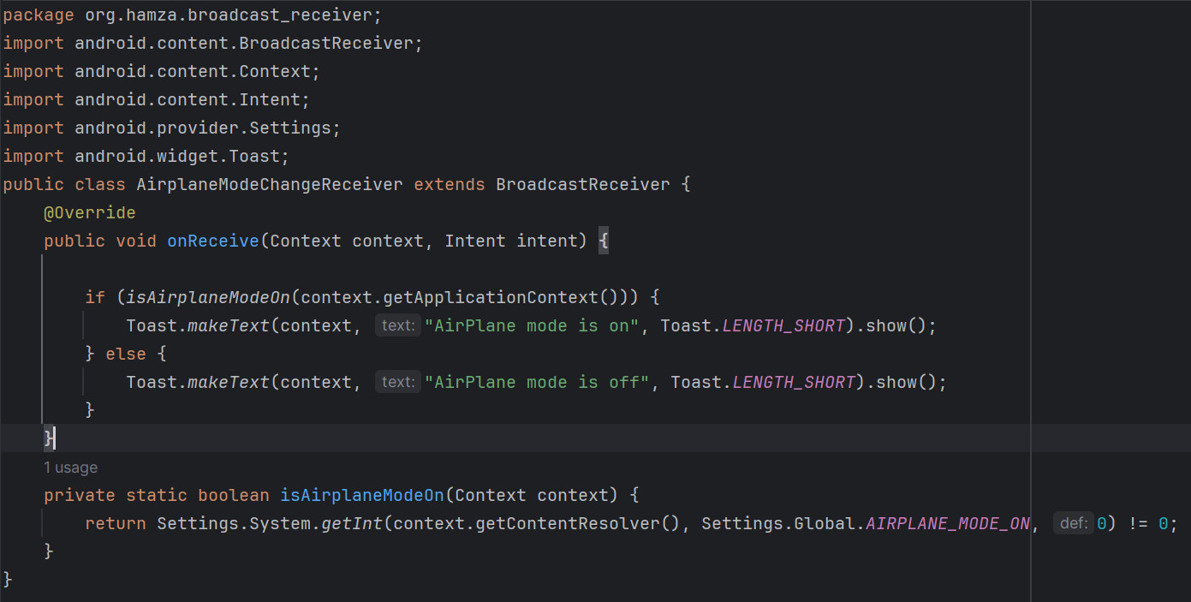
Airplane mode change receiver.java

Slide 24
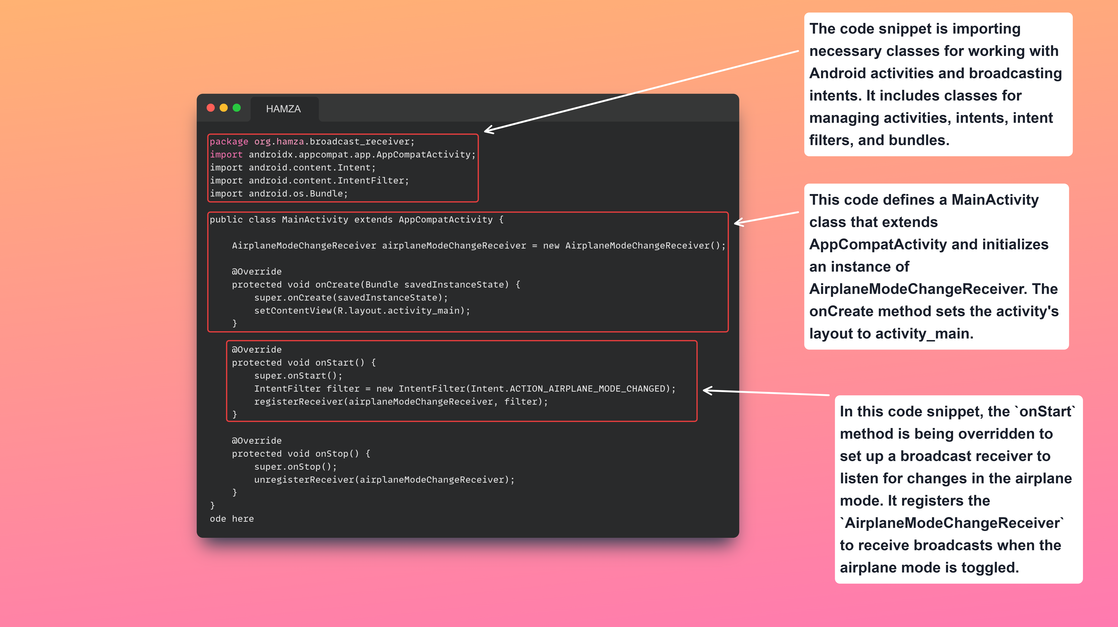

Slide 25
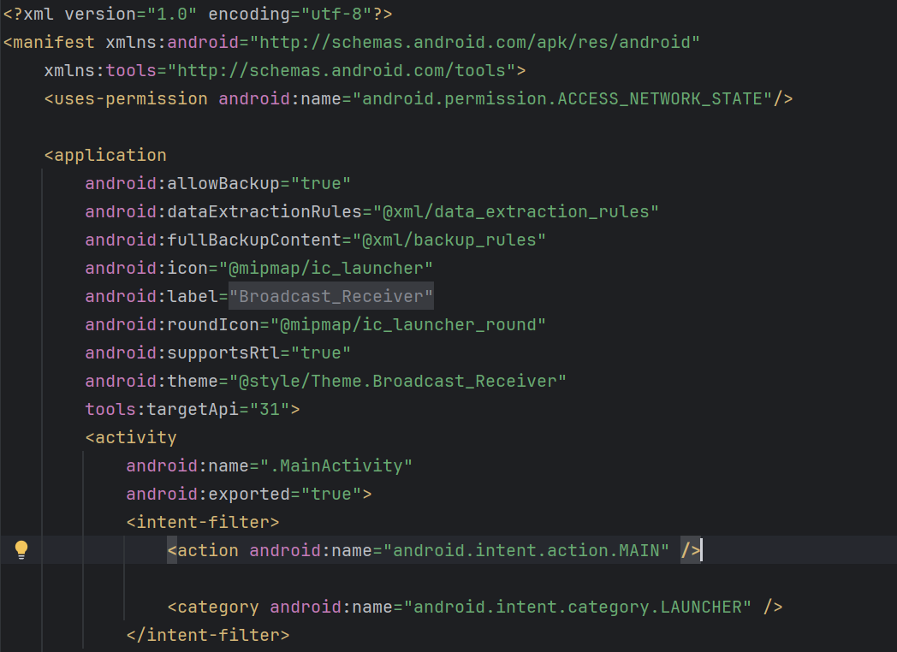
Manifest.xml

Slide 26
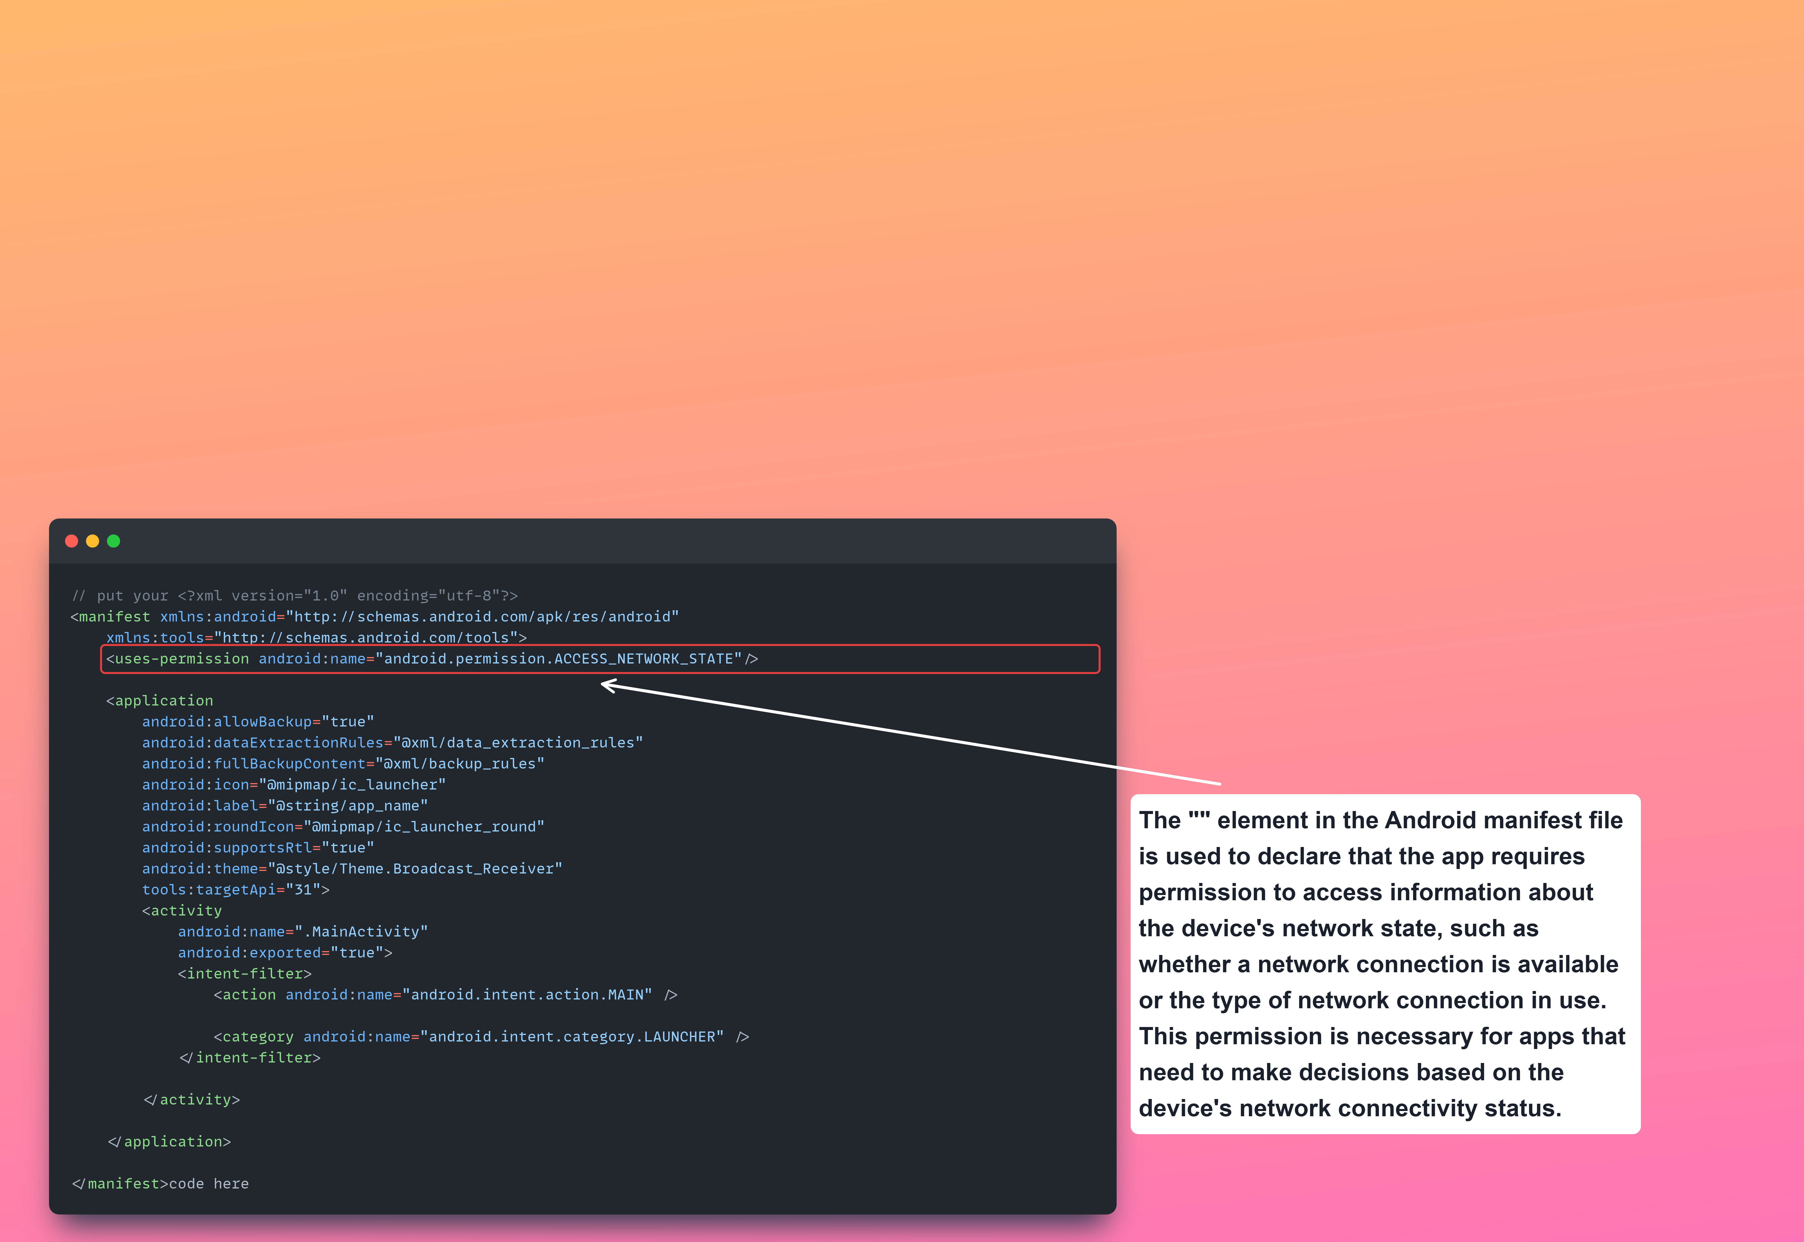

Slide 27
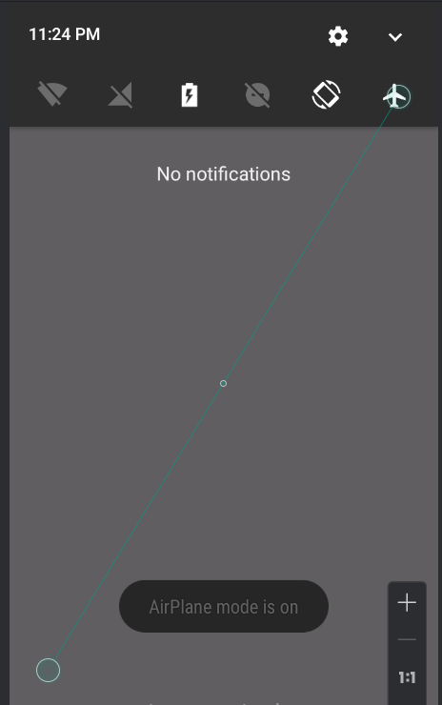
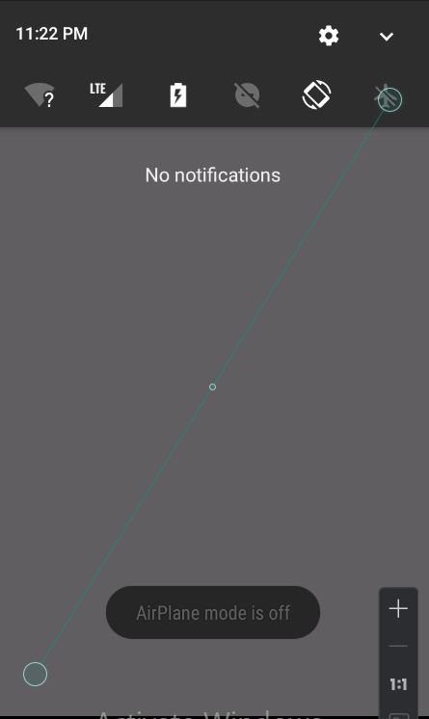
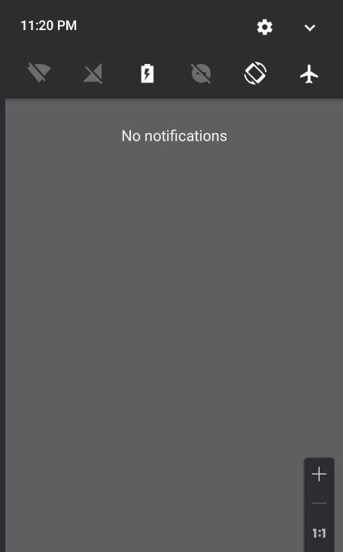
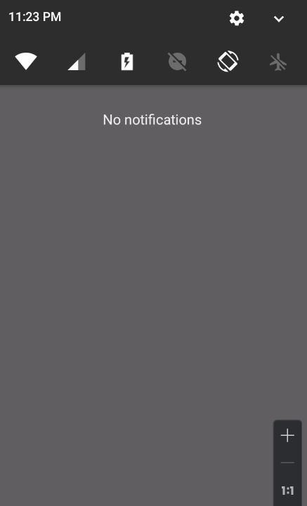
Output:

Slide 28
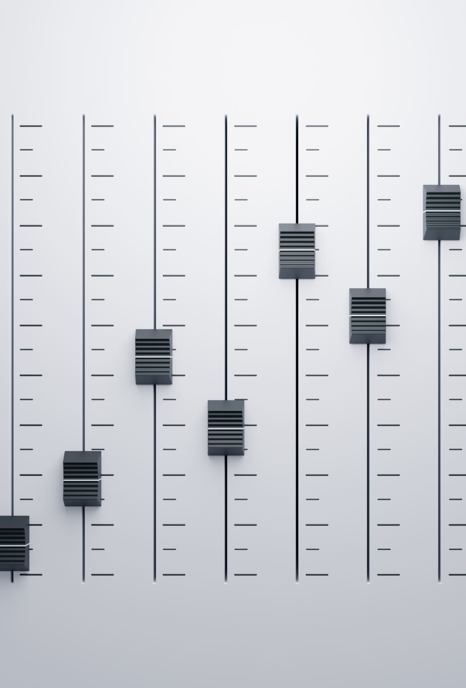
Task : 1
Create an application named Debug Console having the following UI:
Main purpose of this application to display exceptions occurring in another user
applications through broadcast receivers.
This application must register a custom broadcast receiver having DEBUG_INFO action.
On receiving that broadcast must obtain a timestamp, application name from the associated intent. Other applications must send their app name and a message while timestamp must be managed by this application.
Note that the UI contains only one TextView component having a light blue background color with black text.
The text must be scrollable by the user. You may use setMoveraentMethod(new Scrolling Movement Method) to set the scrolling of TextView

Slide 29
Task 2 :
Create an application which can send broadcasts to the DebugConsole (above application). You may use the following UI as reference: On pressing the send button a broadcast with action DEBUG_INFO must be sent to the system. That broadcast must contain the application name as well as a message, given by the user, to be displayed on DebugConsole.

